Slide 1

CTRec: Long-Short Demands Evolution Model for Continuous-Time Recommendation
SIGIR 2019 oral
Presented by Ju Xin

Slide 2
背景
马桶事件
“Dear Amazon, I bought a toilet seat because I needed one. Necessity, not desire. I do not collect them. I am not a toilet seat addict"
在合适的时间推荐合适的商品在推荐中是一大挑战

Slide 3
相关工作
时间序列模型
LSTNet short-term local dependency and long term patterns
RSP the co-occurrences (or dependencies) of items
MC(Morkov Chains ) 、 FPMC 、HRM 、Session based
时间感知模型
Time-LSTM
RNN-based next POI
dynamic dependence of items---Hawkes process
长期需求：捕捉重复购买信息
序列模型中：考虑时间间隔

Slide 4
挑战与创新点
挑战
meet users’ purchase demands at the right time
capture the complex time-sensitive correlations among items
the information of associated items in a short time
贡献
A Demand-aware Hawkes Process (DHP) framework ： model demand evolution in continuous time.
two kinds of user purchase demands: long term demands and short-term demands
Experiment super well. Learn the purchase cycles of products and estimate the real purchase time of a product given a user.

Slide 5

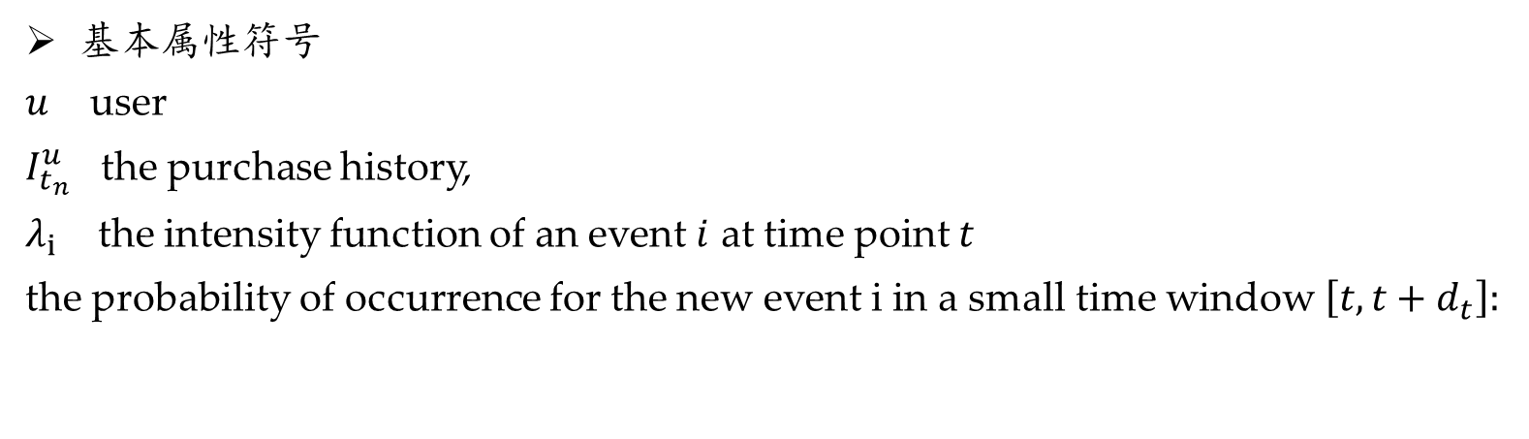
模型
基本属性符号
$u$ user
$I_{t_{n}}^{u}$ the purchase history,
$λ_{i}$ the intensity function of an event $i$ at time point $t$
the probability of occurrence for the new event i in a small time window $\left[t,t+d_{t}\right]:$

Slide 6
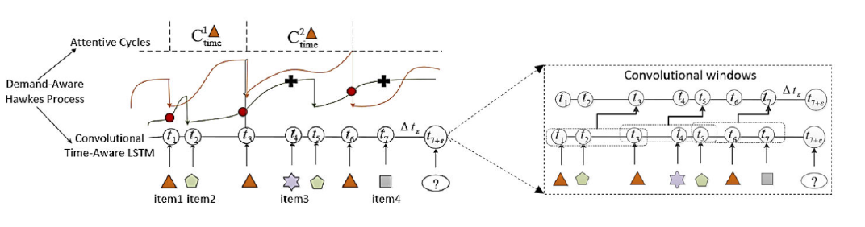

模型
短期需求——卷积LSTM
长期需求——注意力循环
霍克斯过程中的激励效应随着长期需求的周期性增加而增加，短期需求的周期性减少

Slide 7

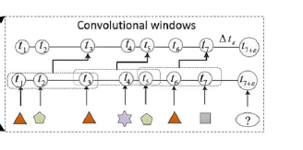

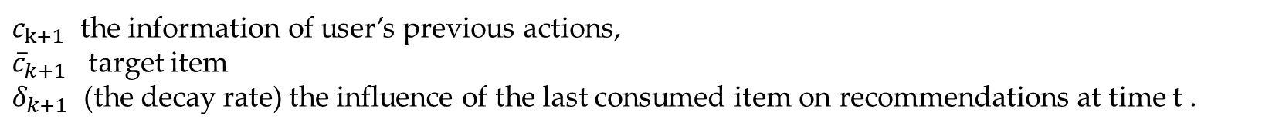
模型
Short-Term Demands by Convolutional Time-Aware LSTM
卷积表示（用户的短期需求可以看作是项目之间在接近时间范围内的局部序列模式）
Time-Aware LSTM（进一步考虑连续时间）
$c_{k+1}$ the information of user’s previous actions,
${\overline{c}}_{k+1}$ target item
$δ_{k+1}$ (the decay rate) the influence of the last consumed item on recommendations at time t .

Slide 8
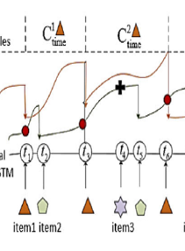


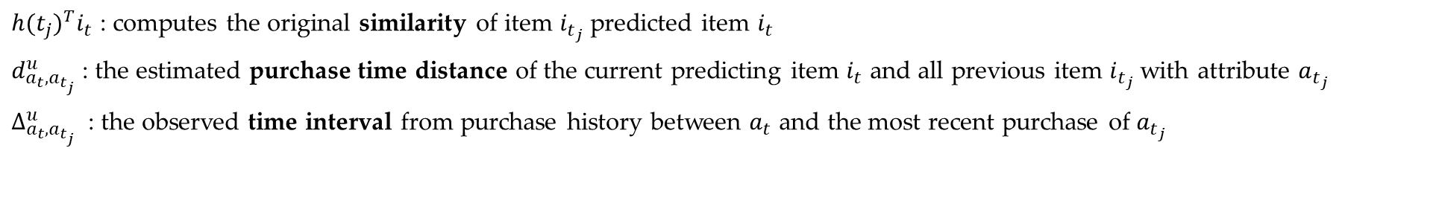
模型
Long-Term Demands by Self-Attentive Mechanism
如果一件商品是很久以前消费的，它很难通过时间感知的LSTM捕捉到需求对当前的购买产生的影响，假设产品的周期性购买需求随着时间的推移而增加，用户经常会购买相似的商品
${h(t_{j})}^{T}i_{t}$ : computes the original similarity of item $i_{t_{j}}$predicted item $i_{t}$
$d_{a_{t},a_{t_{j}}}^{u}$ : the estimated purchase time distance of the current predicting item $i_{t}$ and all previous item $i_{t_{j}}$with attribute $a_{t_{j}}$
$∆_{a_{t},a_{t_{j}}}^{u}$ : the observed time interval from purchase history between $a_{t}$ and the most recent purchase of $a_{t_{j}}$

Slide 9
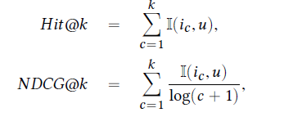
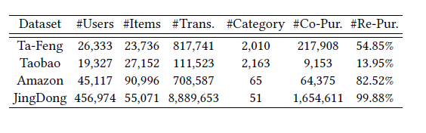
实验
预测能力
对比实验
BPR FPMC
RRN NARM
STAMP RMTPP Time-LSTM
指标
数据集

Slide 10
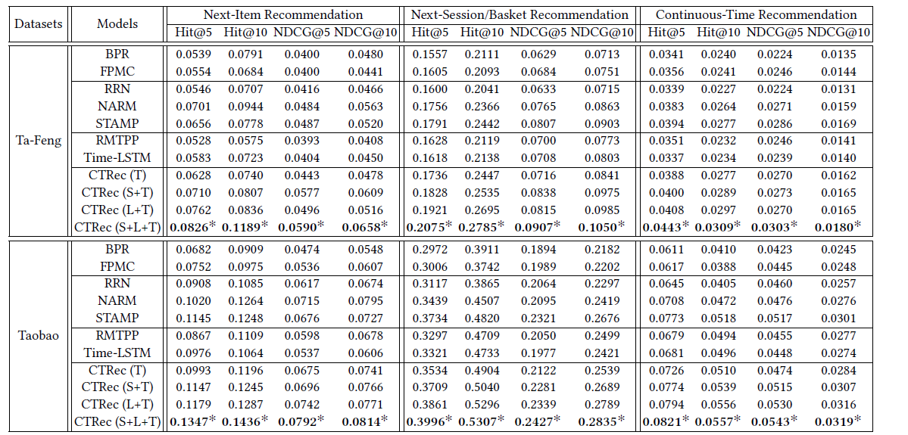
实验
对比实验

Slide 11
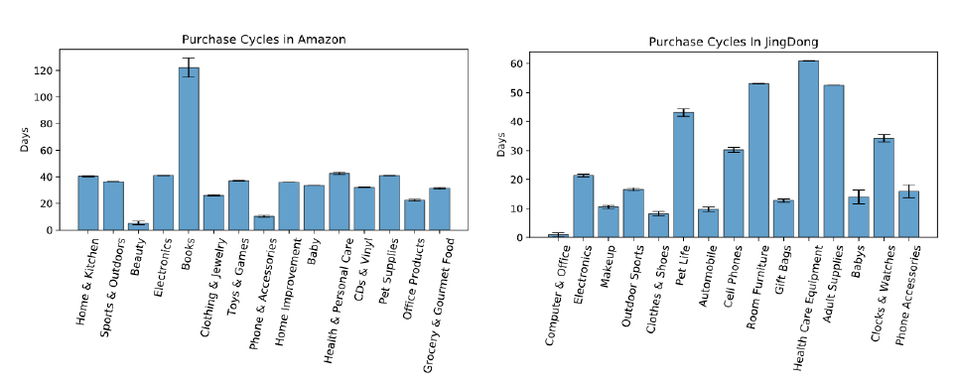
实验
对比实验
Attribute-Level Purchase Cycles
Purchase cycles on category-level in Amazon and JingDong datasets

Slide 12
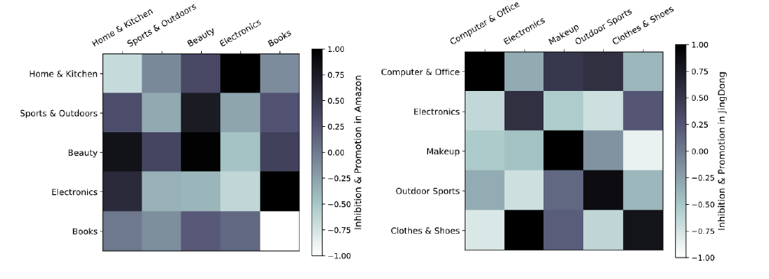
实验
对比实验
Purchase Dependency among Categories
Promotion and inhibition influence among different product categories.

Slide 13
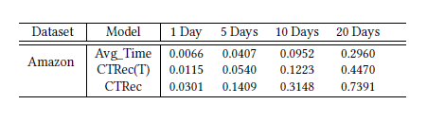
实验
对比实验
The Accuracy of Predicting Repurchase Time

Slide 14
规格严格，功夫到家
感谢聆听指正

